Slide 1
VALUES

Slide 2
Why are values important?
Foundation for understanding people’s motivation and attitudes
Values influences our perceptions
The values one carries can ‘cloud’ an individual’s objectivity and rationality.
Gives insight into what makes a person ‘tick’.

Slide 3
Value
Values represents basic convictions
Carries an individual’s opinion/ judgement as to what is ‘right’, ‘wrong’, ‘good’ or ‘desirable’, etc..
Values have both Intensity and Content
Content refers to whether a ‘mode of conduct’ is important
Intensity refers to ‘how important’ is that mode of conduct.

Slide 4
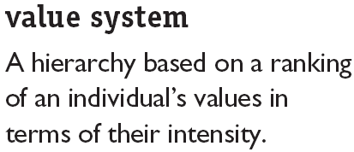
A significant portion of our values are stable and enduring. Established from our early years …from parents, teachers, society, others.
In other words, our values are generally not flexible.

Slide 5

Approaches towards classifying values
Rokeach Value Survey (Milton Rokeach)
Consists of two sets of values with each set containing 18 individual items

Slide 6
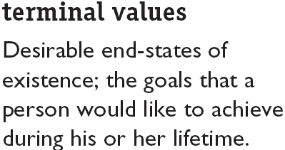
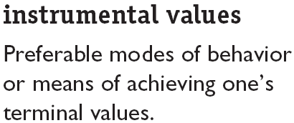
Rokeach Value Survey

Slide 7
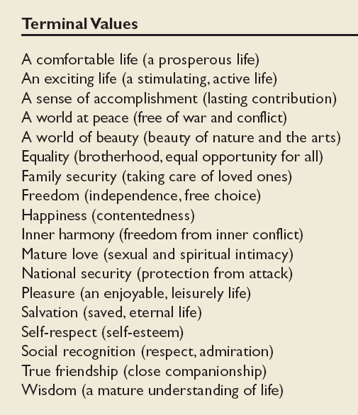
Values in the Rokeach Survey

Slide 8
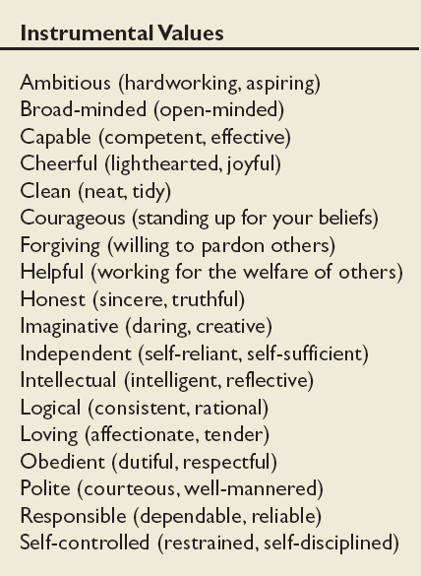
Values in the Rokeach Survey
(cont’d)

Slide 9
RVS values differs among groups
People in the same group or occupation tend to have similar values.
Significant differences can be a problem area (leading to conflicts) especially in negotiations

Slide 10
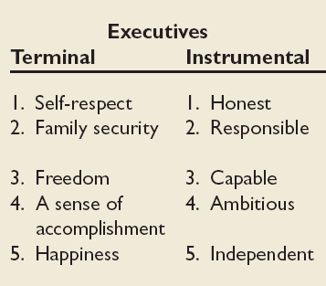
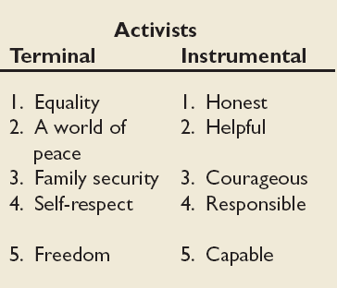
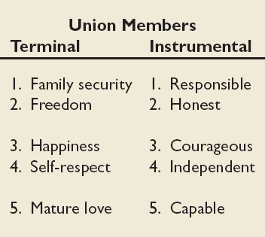
Mean Value Rankings of Executives, Union Members, and Activists

Slide 11
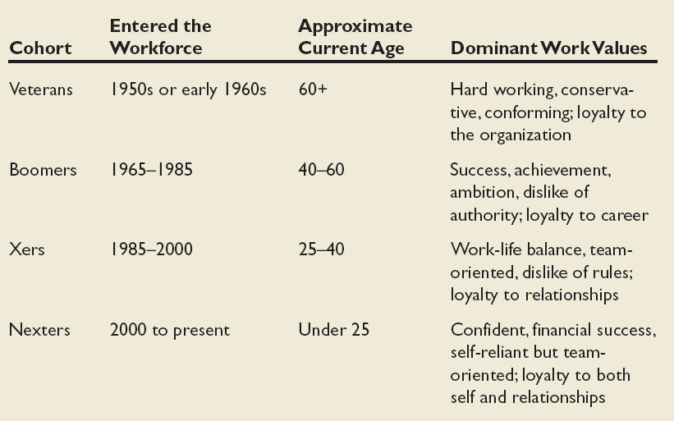
Dominant Work Values in Workforce

Slide 12
Values, Loyalty, and Ethical Behavior
Ethical Climate in
the Organization
Ethical Values and Behaviors of Leaders

Slide 13
Geert Hofstede’s Five Value Dimensions (1970s)
Values differs across cultures... Therefore there is a need to understanding these differences to better predict behaviour of employees from different countries.
Hofstede’s : Widely used approach for analysing variations among cultures with respect to Work Related Values.
Study of 116,000 IBM employees across 40 countries.
Result? Managers and employees vary on 5 value dimensions of national culture
Power Distance
Individualism versus Collectivism
Quantity of life and Quality of Life
Uncertainty Avoidance
Long-term versus Short-term Orientation

Slide 14
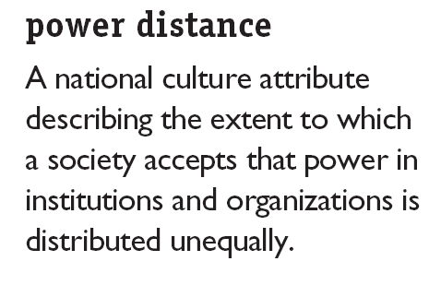
Hofstede’s Framework for Assessing Cultures
High PD Rating = large inequalities of power and wealth exists and is tolerated in the culture…leading to class/ caste system that discourages upward mobility of its citizen.
Low PD Rating = stresses on equality and opportunity

Slide 15
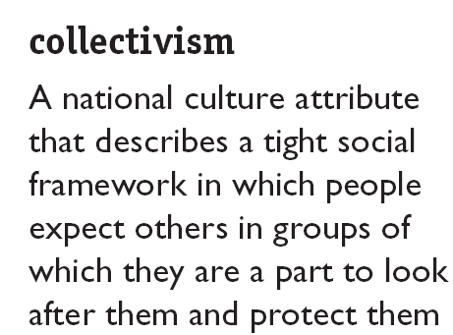
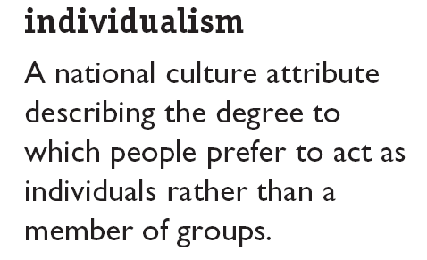

Hofstede’s Framework (cont’d)

Slide 16

Hofstede’s Framework (cont’d)
Masculinity
Degree to which a culture favours traditional masculine roles (achievement, power, control) versus a culture that views men and women as equals
Has separate roles for men and women with men dominating
Femininity
Little differentiating between male and female roles. More equality between men and women

Slide 17

Hofstede’s Framework (cont’d)
Uncertainty Avoidance
Degree to which people in a country prefer structured over unstructured situations.
High Scores in UA implies the country tend to emphasise laws, regulations, controls, to reduce uncertainty and ambiguity.
Low scores in UA implies cultures that are less rule oriented, greater tolerance for opinions, more readily acceptance of change.

Slide 18

Hofstede’s Framework (cont’d)
Long term orientation
Degree of a society’s long term devotion to traditional values.
Looking to the future and value thrift, persistence and tradition
Short term orientation
People value the here-and-now.
Readily accept change

Slide 19
Hofstede’s cultural values by nation
country | power distance |  | indiv vrs coll |  | masc vrs fem |  | uncer avoid |  | long vrs short term
 | index | rank | index | rank | index | rank | index | rank | index | rank
Australia | 36 | 41 | 90 | 2 | 61 | 16 | 51 | 37 | 31 | 22
Denmark | 18 | 51 | 74 | 9 | 16 | 50 | 23 | 51 | 46 | 10
UK | 35 | 42 | 89 | 3 | 66 | 9 | 35 | 47 | 25 | 28
Japan | 54 | 33 | 46 | 22 | 95 | 1 | 92 | 7 | 80 | 4
Malaysia | 104 | 1 | 26 | 36 | 50 | 25 | 36 | 46
Singapore | 74 | 13 | 20 | 39 | 48 | 28 | 8 | 53 | 48 | 9
India | 77 | 10-11 | 48 | 21 | 56 | 20 | 40 | 45 | 61 | 7
score range: 0 = extremely low, 100 = extremely high

Slide 20
Criticism of Hofstede’s Research
Original data is 30 years old
  a lot has happened since then
Conducted only in one company (IBM)

